Slide 1
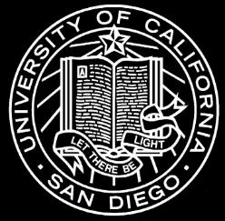
45 year old osteoradiology fellowship presenting 1 year after the onset of multiple pains in the neck.
UCSD MSK Fellows 2016-2017

Slide 2



Slide 3

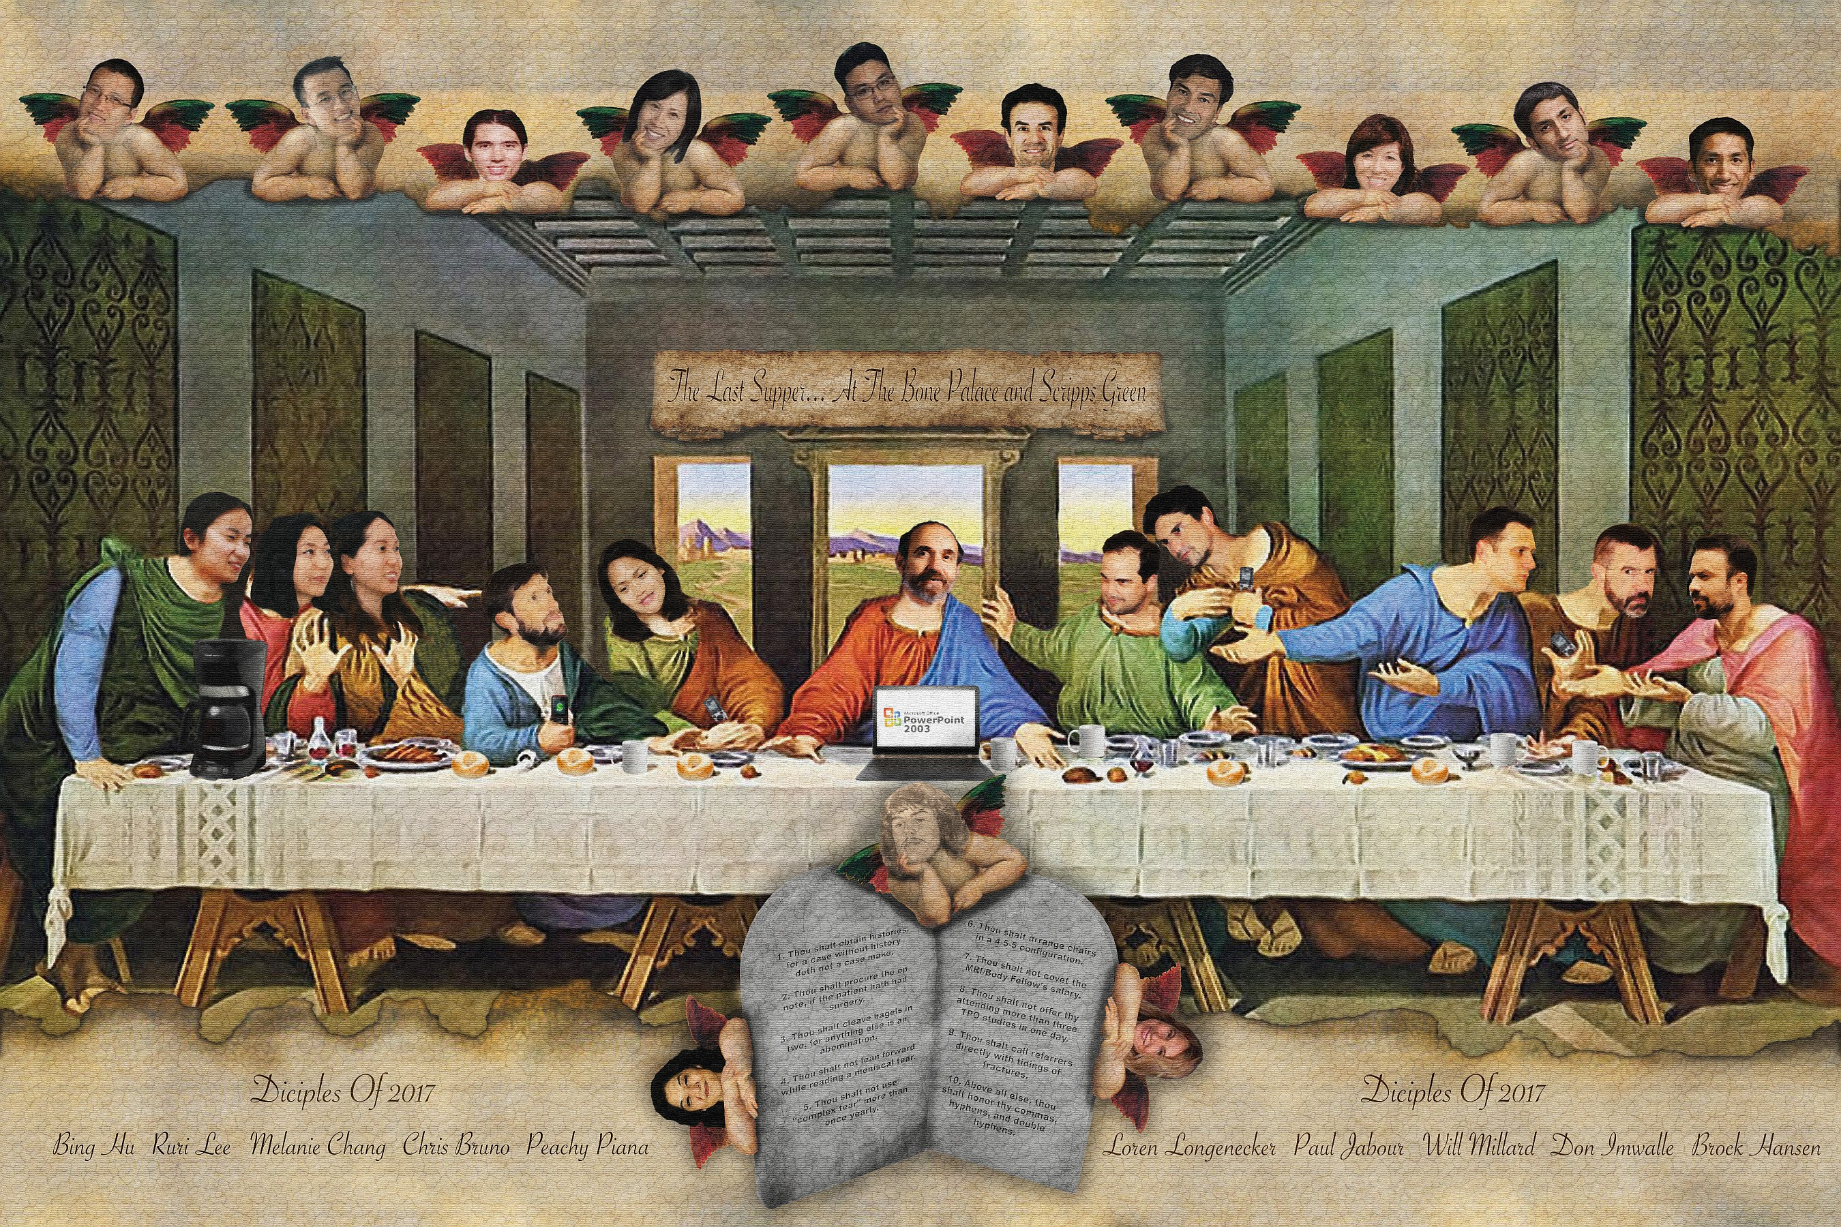

Slide 4
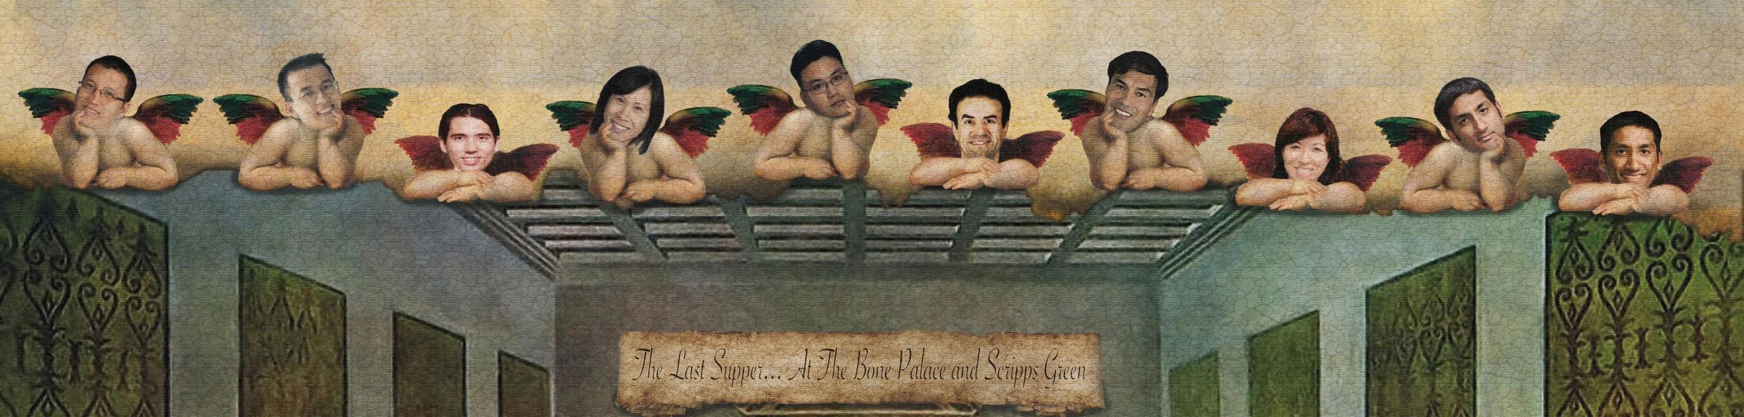

Slide 5
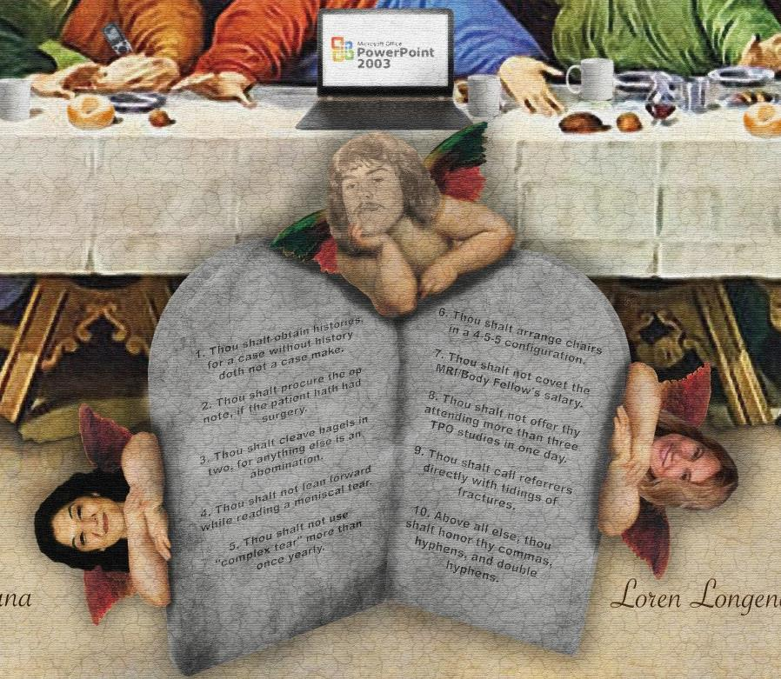
Thou shalt obtain histories, for a case without a history doth not a case make.
Thou shalt procure the op note, if the patient hath had surgery.
Thou shalt cleave bagels in two, for anything else is an abomination.
Thou shall not lean forward when reading a meniscal tear.
Thou shalt not use "complex tear" more than once yearly.
Thou shalt arrange chairs in a 4-5-5 configuration.
Thou shalt not covet thy MRI/Body fellow’s salary.
Though shalt not offer thy attending more than three TPO studies in one day.
Thou shalt call referrers directly with tidings of fractures.
10. Above all else, honor thy commas, hyphens, and double hyphens.
Notes:
Thou shalt obtain histories, for a case without a history doth not a case make.
Thou shalt procure the op note, if the patient hath had surgery
Thou shalt cleave bagels in two, for anything else is an abomination.
Thou shall not lean forward when reading a meniscal tear.
Thou shalt not use "complex tear" more than once yearly.
Thou shalt arrange chairs in a 4-5-5 configuration.
Thou shalt not covet thy MRI/Body fellows salary.
Though shalt not offer thy attending more than three TPO studies in one day
Thou shalt call referrers directly with tidings of fractures.
10. Above all else, honor thy commas, hyphens, and double hyphens.

Slide 6
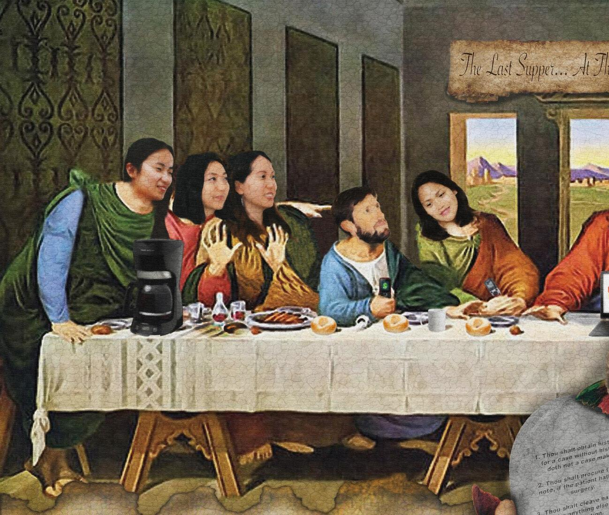

Slide 7
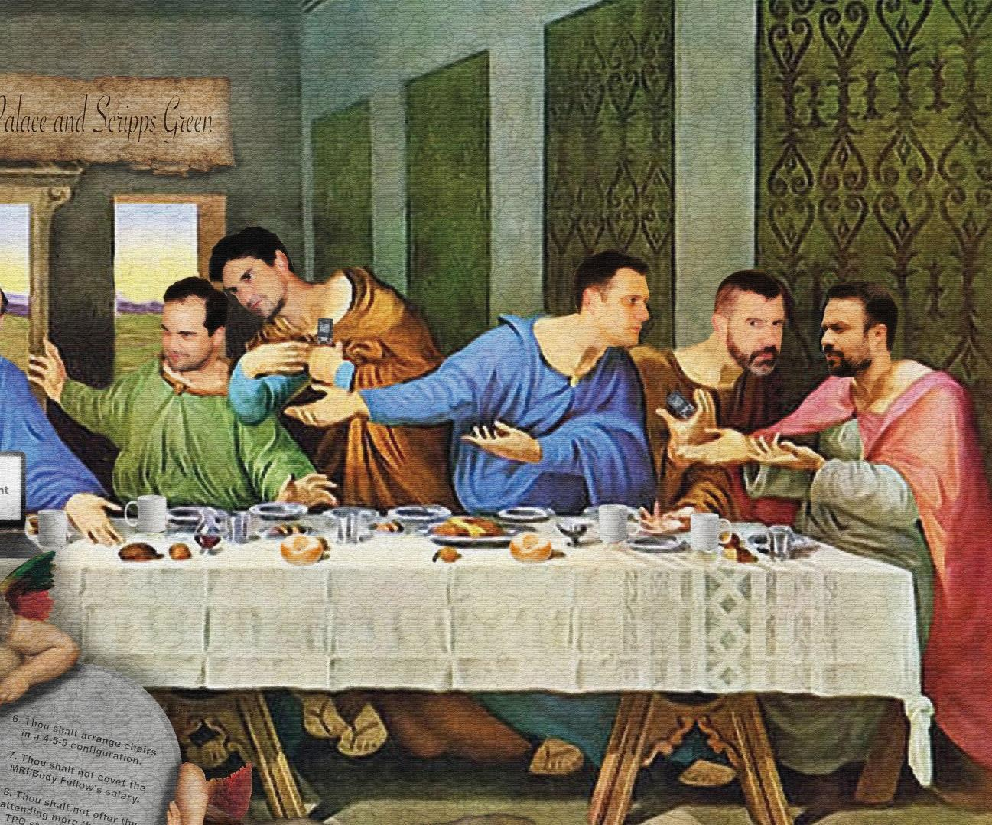

Slide 9
THANK YOU TO EACH AND EVERY ONE OF YOU FOR MAKING THIS SUCH AN AMAZING YEAR!
Bing, Ruri, Melanie, Chris, Peachy, Loren, Paul, Will, Donald, and Brock
UCSD MSK Fellows 2016-2017

